Slide 1

Urban Transportation Is Shifting Gears
Micromobility rises as public transit use declines in global cities.

Slide 2
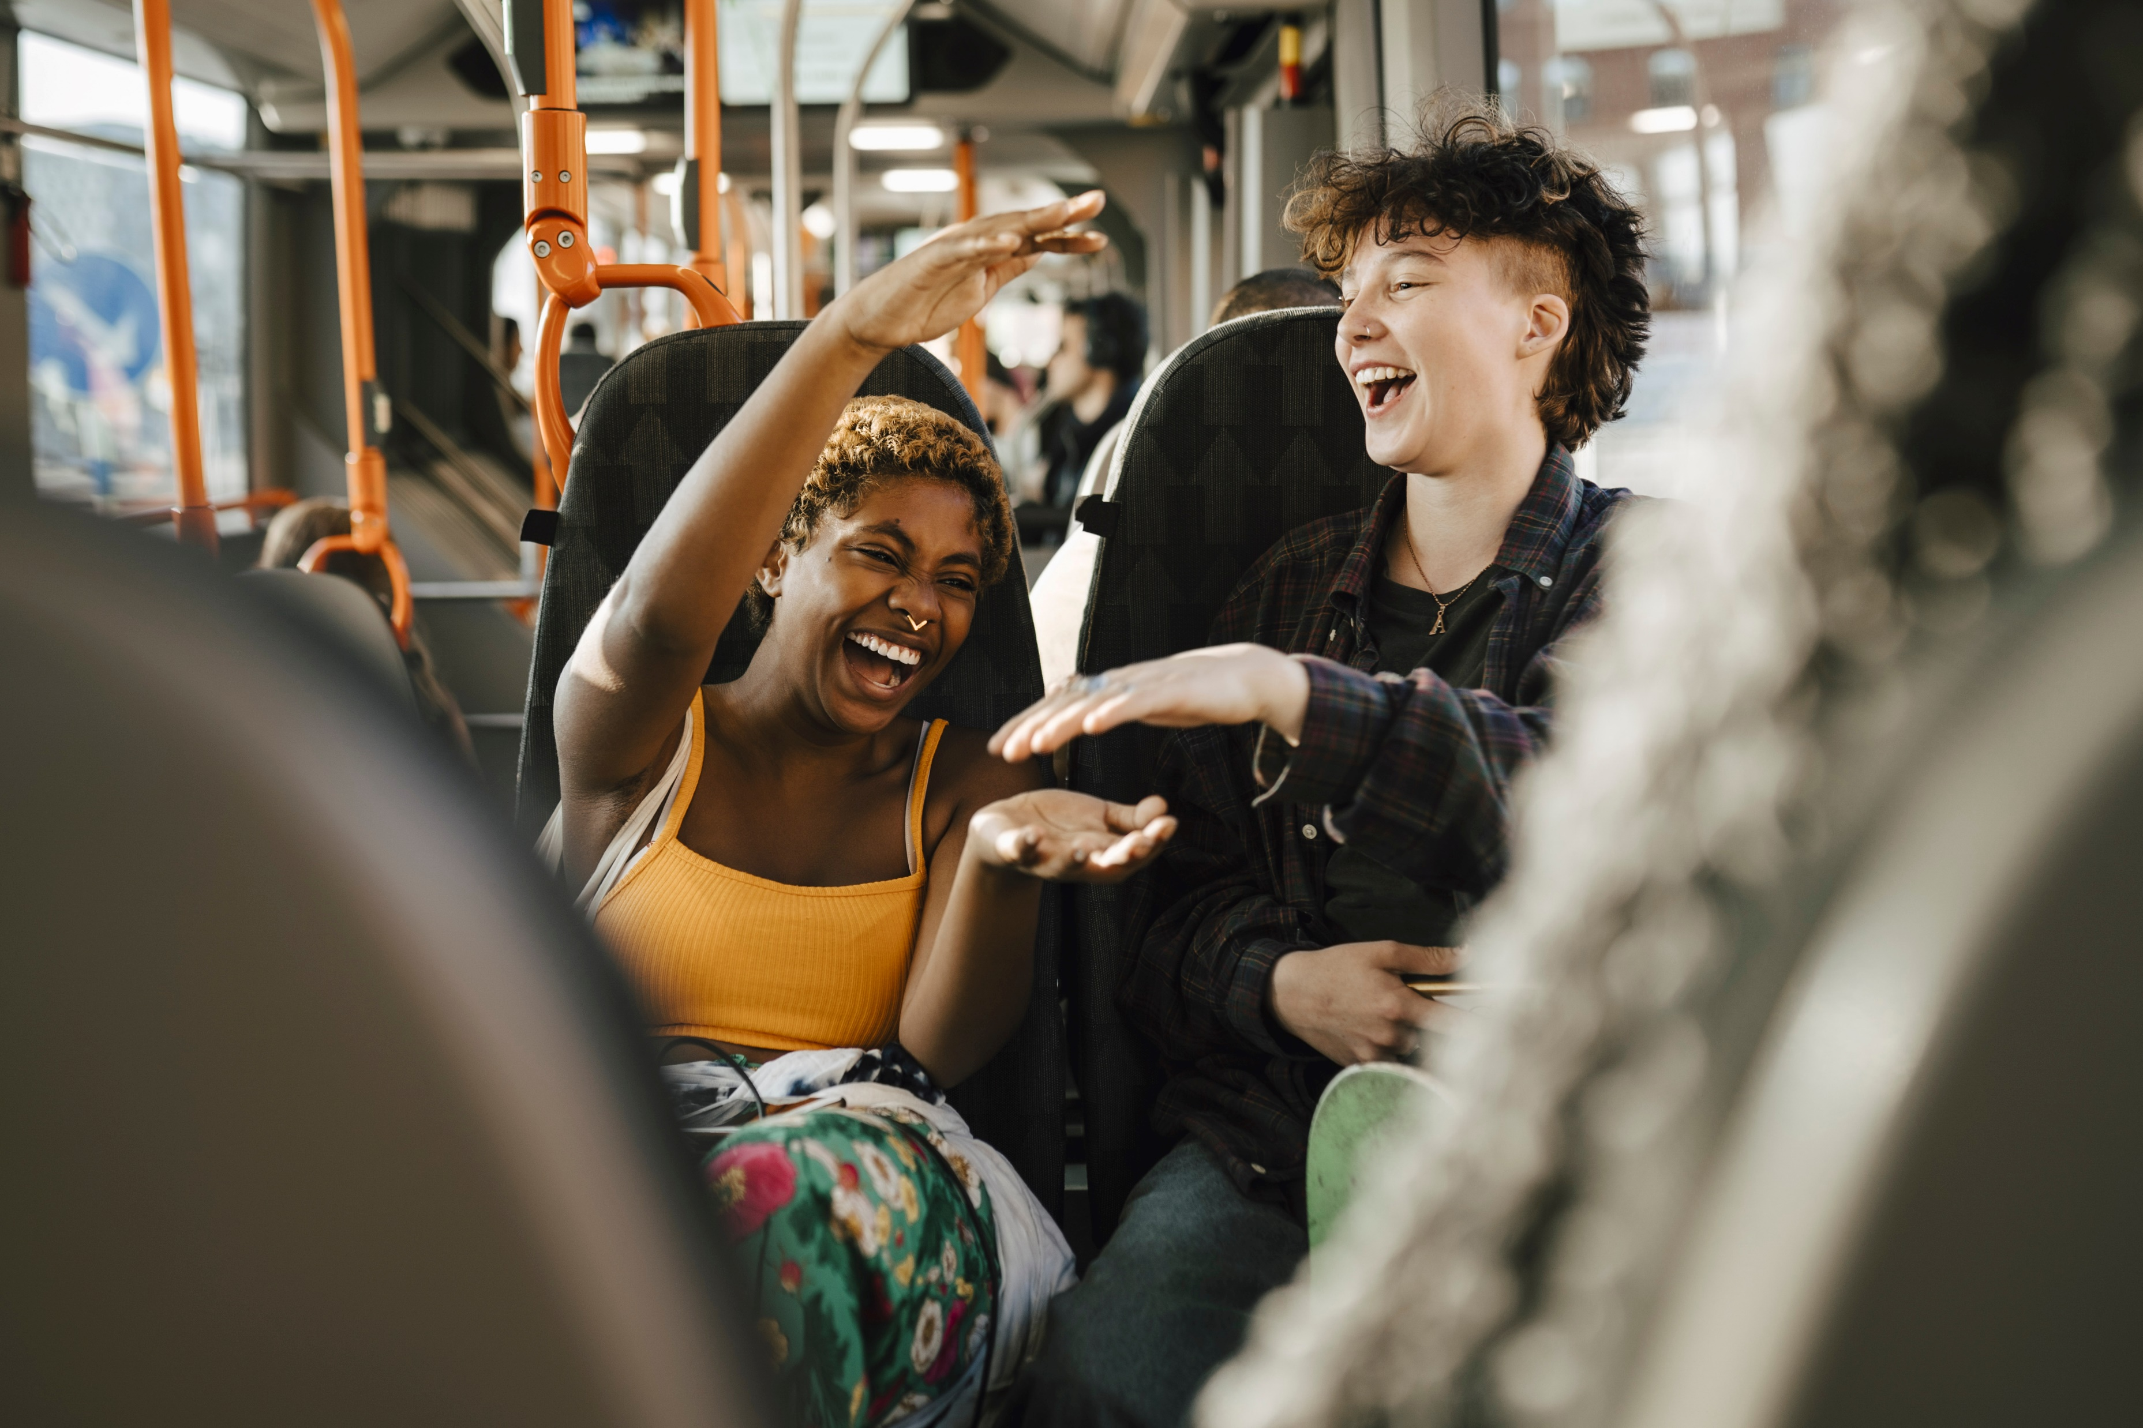
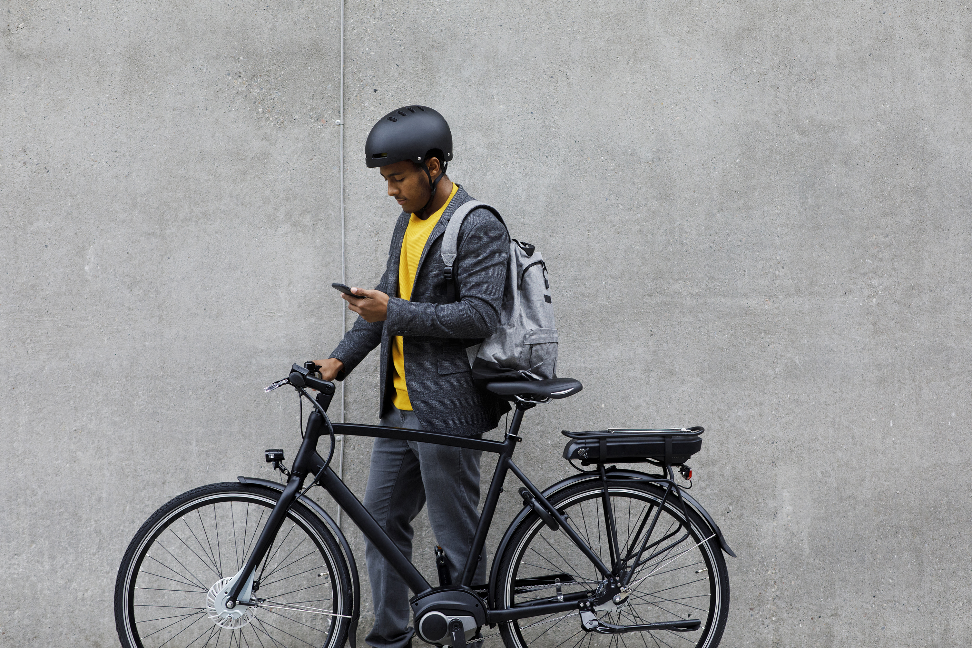
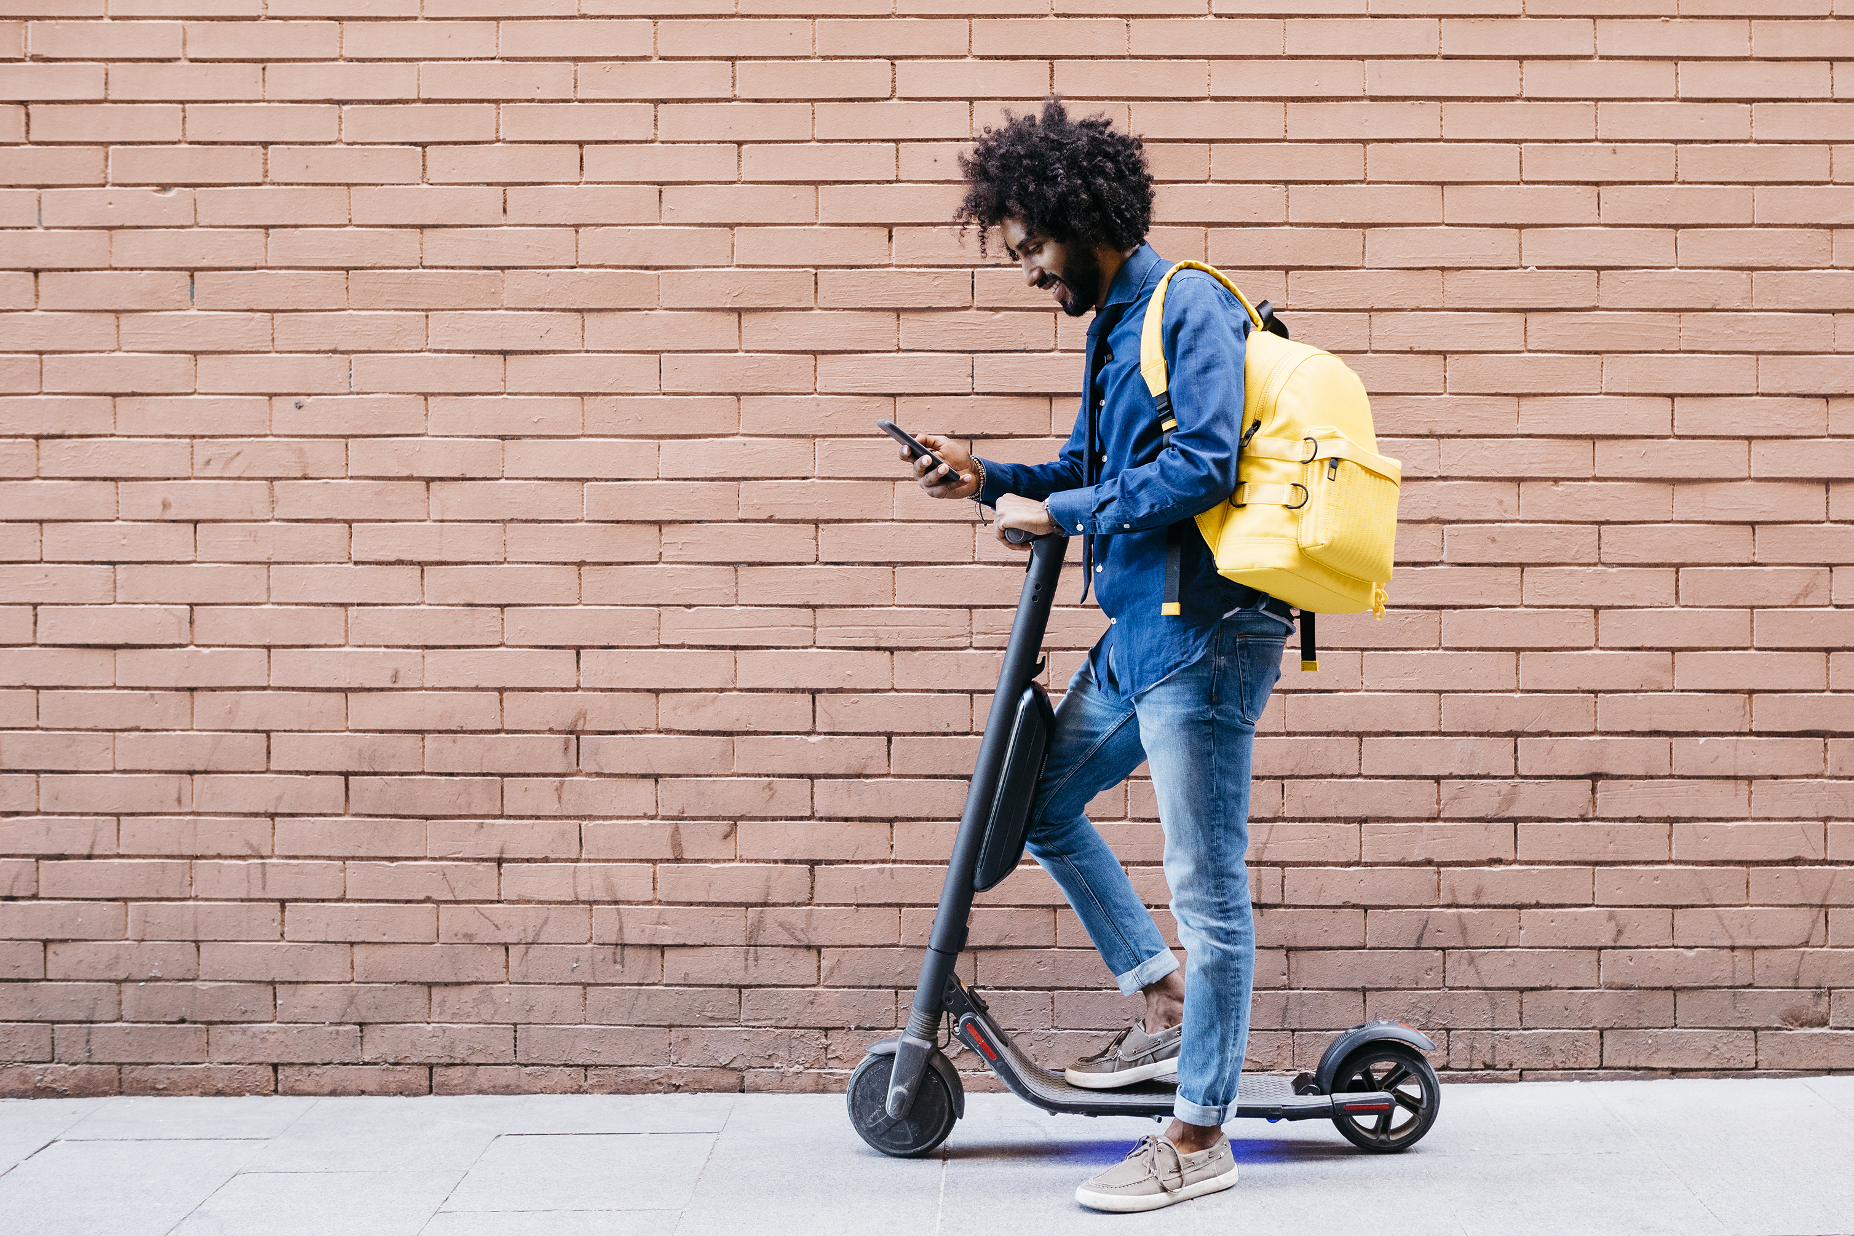
Urban Transportation Trends
In 2079, electric scooters accounted for 18% of all short-distance urban commutes across major cities in the U.S.
Public transportation usage dropped by 12% over the last two years due to remote work and flexible schedules.
Bicycle sharing programs saw a 25% increase in usage during the summer months in European cities

Slide 3

E-Scooters and Bikes Replace Short Car Trips
18%
-12%
+25%
E-scooters
Public transportation
Bicycle sharing
Image source: https://storyset.com/illustration/electric-transport/bro
Notes:
Alternative titles I was thinking of:
Fewer People Are Taking the Bus
How We Move Around Cities Is Changing
City Travel Is Shifting to Two Wheels
Condensed text:
18% of short urban trips now use e-scooters
−12% drop in public transit usage
+25% growth in bike sharing

Slide 4
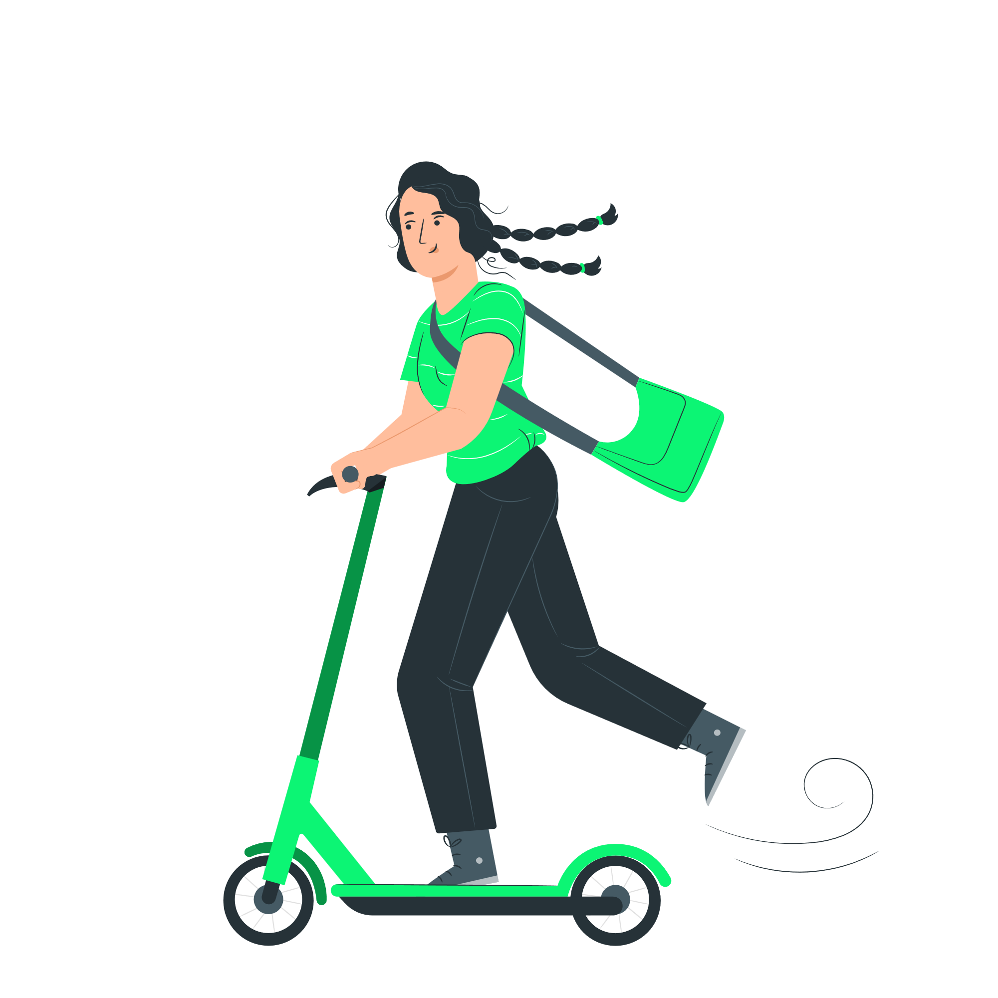
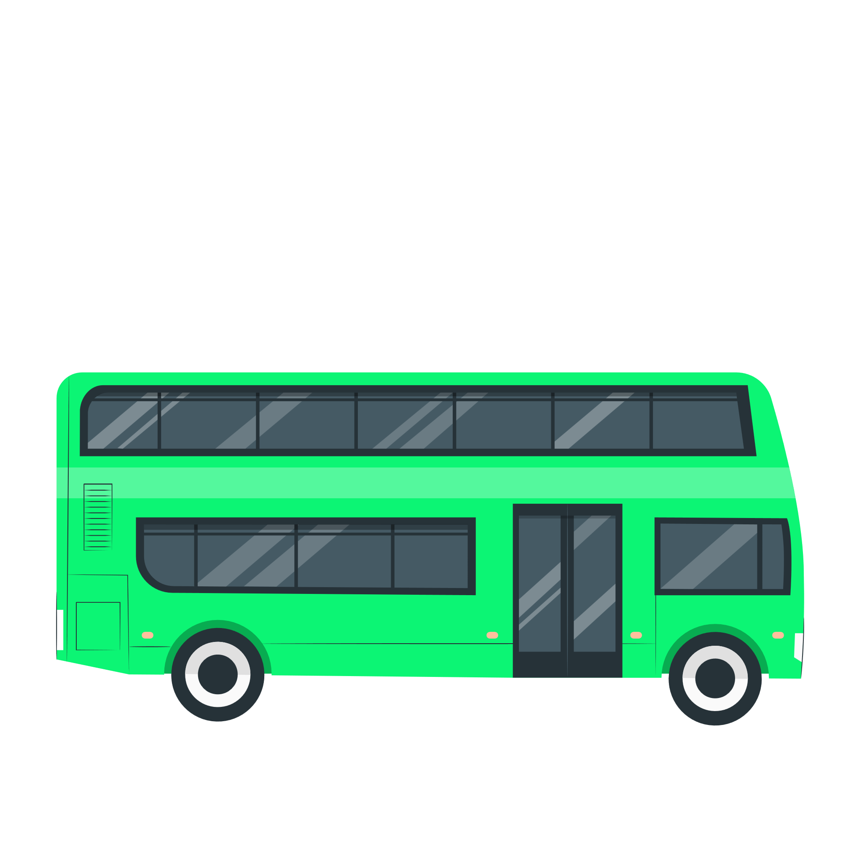

City Travel Is Shifting to Two Wheels
18%
e-scooters
−12%
public transit
+25%
bike sharing
Notes:
Example ready slide #2

Slide 5


E-Scooters & Bikes
Replace Short Car Trips & Bus drives
-12%
+25%
18%
Public transportation
Bicycle sharing
E-scooters
Notes:
Alternative titles I was thinking of:
Fewer People Are Taking the Bus
How We Move Around Cities Is Changing
City Travel Is Shifting to Two Wheels
Condensed text:
18% of short urban trips now use e-scooters
−12% drop in public transit usage
+25% growth in bike sharing

Slide 6
SCALE
Urban Transportation Trends
Electric scooters accounted for 18% of all short-distance urban commutes across major cities in the U.S.
Public transportation usage dropped by 12% over the last two years due to remote work and flexible schedules.
Bicycle sharing programs saw a 25% increase in usage during the summer months in European cities
Urban Transportation Trends
In 2079, electric scooters accounted for 18% of all short-distance urban commutes across major cities in the U.S.
Public transportation usage dropped by 12% over the last two years due to remote work and flexible schedules.
Bicycle sharing programs saw a 25% increase in usage during the summer months in European cities

Slide 7
SCALE
Urban Transportation Trends
Electric scooters accounted for 18% of all short-distance urban commutes across major cities in the U.S.
Public transportation usage dropped by 12% over the last two years due to remote work and flexible schedules.
Bicycle sharing programs saw a 25% increase in usage during the summer months in European cities

Slide 8
SCALE
FORM
18%
-12%
+25%
E-scooters
Public transportation
Bicycle sharing
+25%
18%
-12%
Bicycle sharing
E-scooters
Public transportation

Slide 9
SCALE
FORM
ALIGNMENT
18%
-12%
+25%
E-scooters
Public transportation
Bicycle sharing

Slide 10
18%
E-scooters
-12%
+25%
Public transportation
Bicycle sharing

Slide 11
18%
-12%
+25%
E-scooters
Public transportation
Bicycle sharing

Slide 12
SCALE
FORM
ALIGNMENT
DESIGN

Slide 13
Reduce the text
Work on the alignment and design

Slide 14
TEXT (CONTENT):
Divide
Rank
Reduce
DESIGN:
Form
Align
Color

Slide 15
E-Scooters and Bikes Replace Short Car Trips
18%
-12%
+25%
E-scooters
Public transportation
Bicycle sharing
Image source: https://storyset.com/illustration/electric-transport/bro
Notes:
Alternative titles I was thinking of:
Fewer People Are Taking the Bus
How We Move Around Cities Is Changing
City Travel Is Shifting to Two Wheels
Condensed text:
18% of short urban trips now use e-scooters
−12% drop in public transit usage
+25% growth in bike sharing

Slide 16
E-Scooters and Bikes Replace Short Car Trips
18%
-12%
+25%
E-scooters
Public transportation
Bicycle sharing
Image source: https://storyset.com/illustration/electric-transport/bro
Notes:
Alternative titles I was thinking of:
Fewer People Are Taking the Bus
How We Move Around Cities Is Changing
City Travel Is Shifting to Two Wheels
Condensed text:
18% of short urban trips now use e-scooters
−12% drop in public transit usage
+25% growth in bike sharing

Slide 17
E-Scooters and Bikes Replace Short Car Trips
18%
-12%
+25%
E-scooters
Public transportation
Bicycle sharing
Image source: https://storyset.com/illustration/electric-transport/bro
Notes:
Alternative titles I was thinking of:
Fewer People Are Taking the Bus
How We Move Around Cities Is Changing
City Travel Is Shifting to Two Wheels
Condensed text:
18% of short urban trips now use e-scooters
−12% drop in public transit usage
+25% growth in bike sharing

Slide 18
E-Scooters and Bikes Replace Short Car Trips
18%
-12%
+25%
E-scooters
Public transportation
Bicycle sharing
Image source: https://storyset.com/illustration/electric-transport/bro
Notes:
Alternative titles I was thinking of:
Fewer People Are Taking the Bus
How We Move Around Cities Is Changing
City Travel Is Shifting to Two Wheels
Condensed text:
18% of short urban trips now use e-scooters
−12% drop in public transit usage
+25% growth in bike sharing

Slide 19
1
2
1
2
3
4
3
4
5

Slide 20
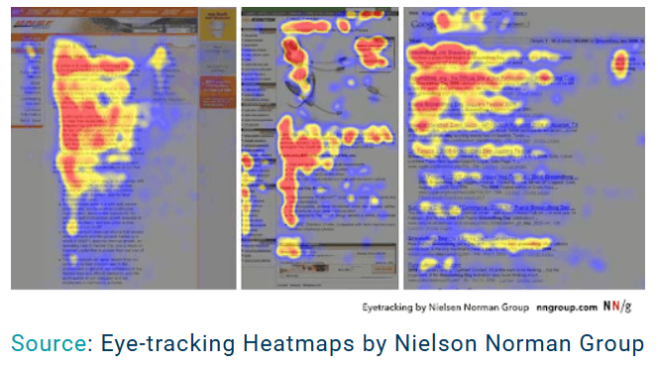

Slide 21
1
2
1
2
3
4
3
4
5

Slide 22
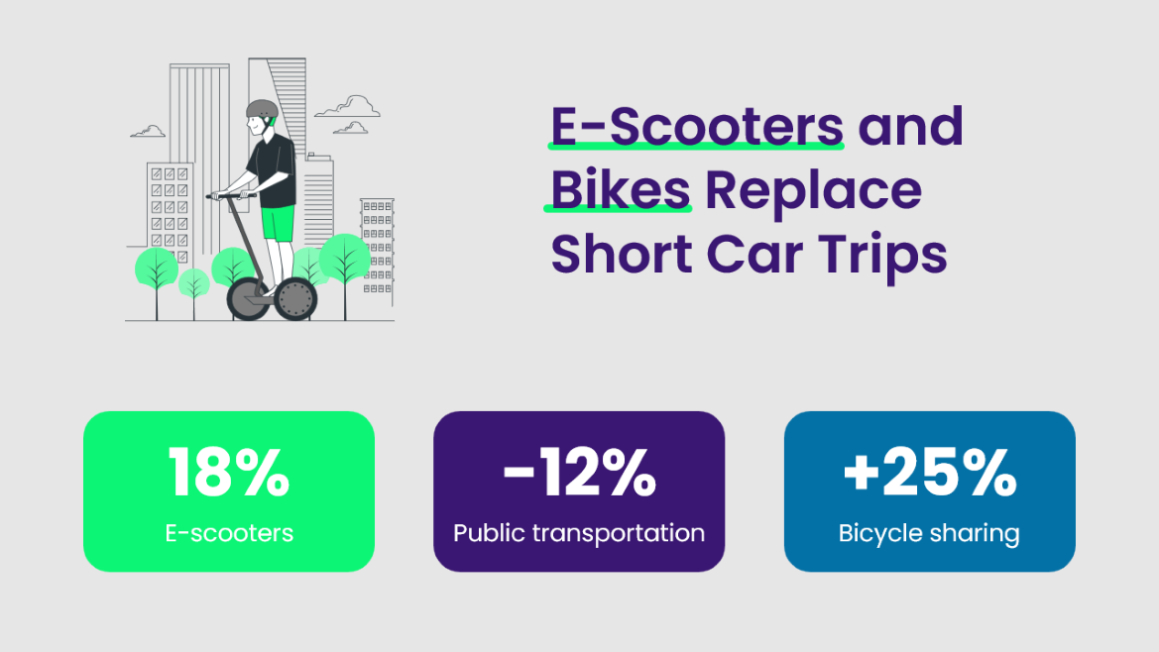

1
2
1
2
3
4
3
4
5

Slide 23
1
2
1
2
3
4
3
4
5

Slide 24
Guttenberg Diagram
1
2
3
4
5

Slide 25
“Freshly” Fruit Juice sales experience significant decrease due to healthier alternatives
Key takeaways between 2039 and 2040:
Sales volume between 2039 and 2040 reduced by 300 thousand units
Gross revenue 5% lower (from 174 mln USD in 2039 to 165 mln in 240 mln
„Freshly” Fruit Juice is mostly sold in stores
Online sales make up only 13% of total sales
Unit sales experience a slow but consistent decline
-300,000 unit sales

Slide 26
“Freshly” Fruit Juice sales experience significant decrease due to healthier alternatives
Key takeaways between 2039 and 2040:
Sales volume between 2039 and 2040 reduced by 300 thousand units
Gross revenue 5% lower (from 174 mln USD in 2039 to 165 mln in 240 mln
„Freshly” Fruit Juice is mostly sold in stores
Online sales make up only 13% of total sales
Unit sales experience a slow but consistent decline
-300,000 unit sales

Slide 27
Work on the content (text):
Divide
Rank
Reduce

Slide 28
Urban Transportation Trends
18% of short urban trips now use e-scooters
−12% drop in public transit usage
+25% growth in bike sharing

Slide 29
Work on the content (text):
Divide
Rank
Reduce
Urban Transportation Trends
In 2079, electric scooters accounted for 18% of all short-distance urban commutes across major cities in the U.S.
Public transportation usage dropped by 12% over the last two years due to remote work and flexible schedules.
Bicycle sharing programs saw a 25% increase in usage during the summer months in European cities
Notes:
Condensed text:
18% of short urban trips now use e-scooters
−12% drop in public transit usage
+25% growth in bike sharing

Slide 30
Urban Transportation Trends
E-scooters
Public transit
Bike sharing
18%
of short urban trips now use
−12%
drop in usage
+25%
growth in

Slide 31
Urban Transportation Trends
18%
of short urban trips now use e-scooters
−12%
drop in public transit usage
+25%
growth in bike sharing

Slide 32
Urban Transportation Trends
1. SCALE – Place them as 3 vertical text boxes. Consider making title bigger
2. FORM – Pick a design or template you’d like to follow
3. ALIGNMENT – Group and align boxes
4. DESIGN – Color? Contrast? Symmetry?
18% of short urban trips now use e-scooters
−12% drop in public transit usage
+25% growth in bike sharing

Slide 33
E-Scooters and Bikes Replace Short Car Trips
18%
-12%
+25%
E-scooters
Public transportation
Bicycle sharing
Notes:
Example ready slide #1

Slide 34
City Travel Is Shifting to Two Wheels
18%
e-scooters
−12%
public transit
+25%
bike sharing
Notes:
Example ready slide #2

Slide 35
1. Reduce text within the 3 boxes completely
2. Position shapes
3. Use Colors from the template
4. Modify the size, position them nicely, you can do it! Use center alignment, distribution
5. Adjust the title design. Consider adding an icon if you feel like it. Use brand color if you prefer.
Urban Transportation Trends
E-scooters
Public transit
Bike sharing
18%
of short urban trips now use
−12%
drop in usage
+25%
growth in

Slide 36
Reduce the text
Work on the alignment and design

Slide 37
CONTENT:
Divide
Rank
Reduce
DESIGN:
Form
Align
Color

